Slide 1
Social and Cultural Differences between Regions in Belgium [Coursera – IBM Data Science – Capstone project]
Sven De Smit

Slide 2
Business Understanding
Problem statement
Many Belgian companies – especially the multi-nationals located in Brussels – are working with a mix of employees from both parts of the country. Those companies already found a way to deal with the language difference, but the HR departments of those companies would also want to take into account cultural and social differences – if they exist.
The hypothesis that we want to validate:
There are important social and cultural differences between northern (Dutch-speaking) and southern (French-speaking) cities in Belgium.
does

Slide 3
Analytical Approach
We believe that a natural way to characterize a city - and the people that live in that city - is by the popularity of its venues. For example by tallying the amount of parks, bars, restaurants or universities it has relative to all other types of venues, one can get a sense of the cultural and social character of a city.
Therefore, if we could lay our hands on data w.r.t. what the popular venues are in each city, we could use clustering techniques to classify cities into categories. These categories can then be visualised on a map to get an idea about the geographical dispersion of the categories. If there is a difference between categories mainly appearing in the south and categories mainly appearing in the north, we have proven our hypothesis.
does

Slide 4
Data acquisition
Belgian cities data [source: wikipedia https://nl.wikipedia.org/wiki/Tabel_van_Belgische_gemeenten ]
A table that published on the Dutch Wikipedia that gives an overview of the cities in Belgium with some key metadata (name of the city, province, number of habitants, acreage, habitants per km², prosperity index
Geo-location data [source: Python geopy package]
In order to visualize the cities on a map of Belgium we need their geo-location (latitude-longitude). This location can be retrieved using the geopy package in Python.
Multi-language city names [source: economie.fgov.be KBO-codes-identificatie.xls]
Many cities in Belgium have different names in the different languages. The following file that is published by the federal government contains the city names for the three languages.
City venues data [source: Foursquare Places API]
A good source of information for venues all over the world is Foursquare. One can easily find popular venues in a city or a location by using the explore function in the Place API.
Geo-location data for city borders in Belgium [source: municipalities-belgium.geojson]
In order to visualize our results in a Folium choropleth, we need a geo-json file containing the location data for the city borders. We found one in GitHub. It’s not a very recent one, but it will do the trick for this project.

Slide 5
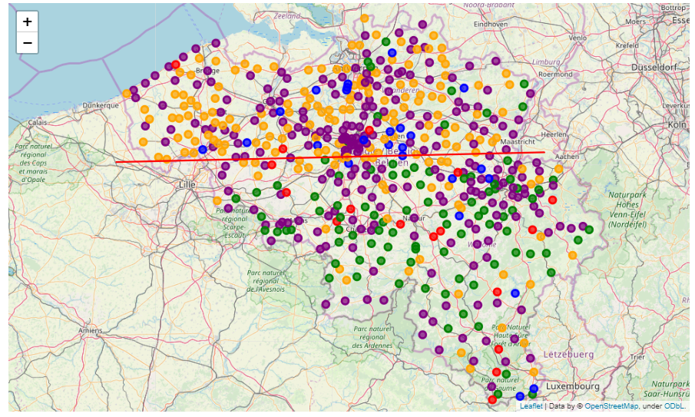
Pubs Places - typical dutch
Quite & local tourism
Quite place
Big & Medium-size Cities
Food & Shops - typical french

Slide 6
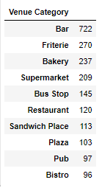
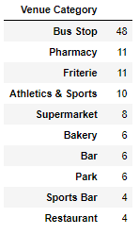
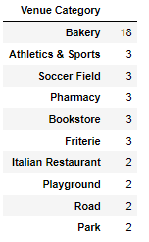
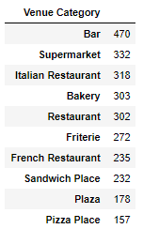
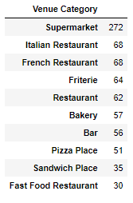
Pubs Places - typical dutch
Quite & local tourism
Quite place
Big & Medium-size Cities
Food & Shops - typical french

